Slide 1
Making maps with QGIS
Reka Solymosi
reka.solymosi@manchester.ac.uk

Slide 2
Most social processes are spatial

Slide 3
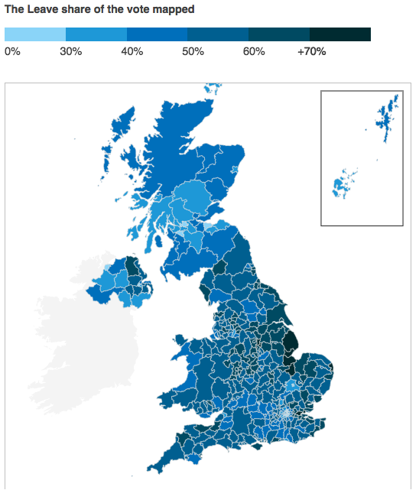

Slide 4
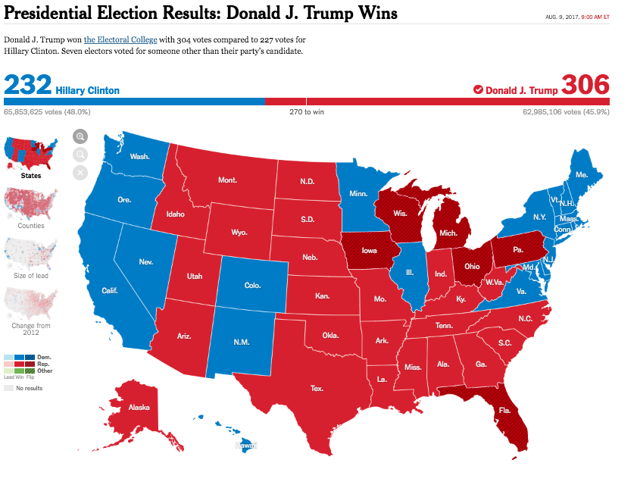

Slide 5
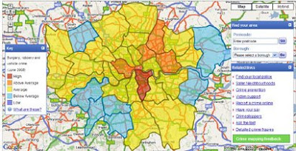

Slide 6
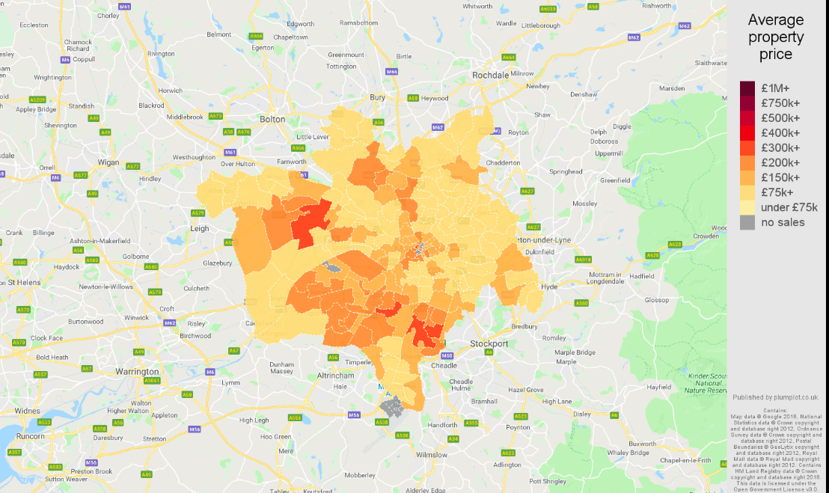

Slide 7
GIS
Geographic
Information
Science (or systems)
Notes:
A geographic information system (GIS) is a computer system for capturing, storing, checking, and displaying data related to positions on Earth's surface. GIS can show many different kinds of data on one map. This enables people to more easily see, analyze, and understand patterns and relationships.

Slide 8
How do you make a map?
Need spatial information
Point
Line
Polygon

Slide 9
Points

Slide 10
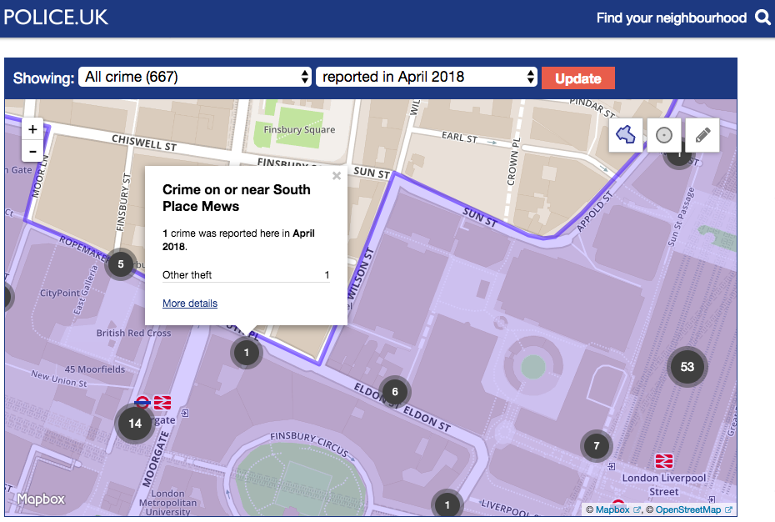

Slide 11

Notes:
https://www.citylab.com/life/2014/11/what-twitter-tells-us-about-unemployment/382840/

Slide 12
How can you map…
Attraction | Coordinates
Theodore Roosevelt National Park | 46.9157498, -103.5245016
North Dakota Cowboy Hall of Fame | 46.9138046, -103.5260442
Mount Rushmore National Monument | 43.875419, -103.4531437
Ashland Strategic Air and Space Museum | 41.0153413, -96.3210015

Slide 13
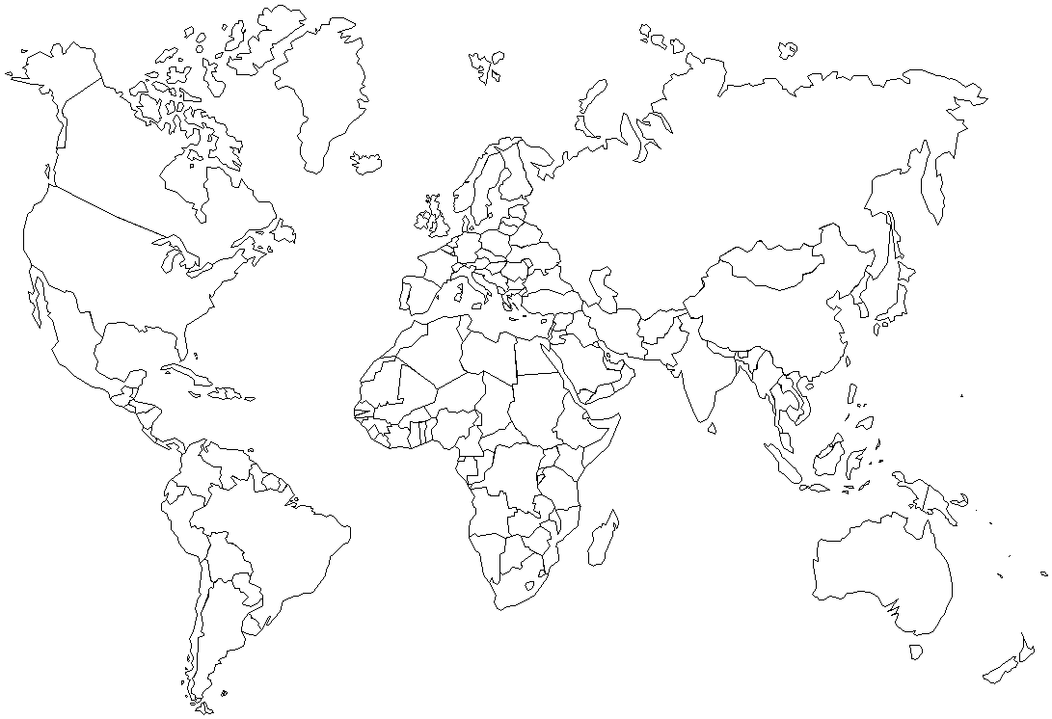
Latitude
Longitude

Slide 14
Lines

Slide 15
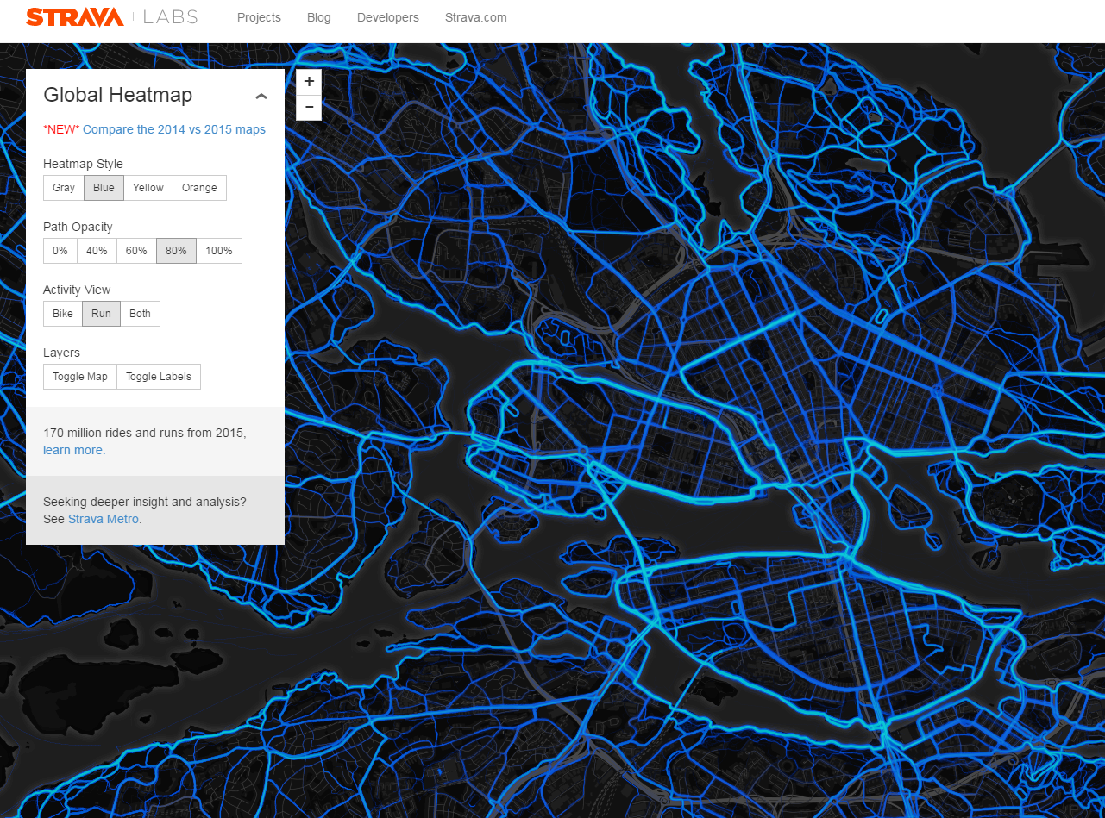
Notes:
http://labs.strava.com/heatmap/

Slide 16
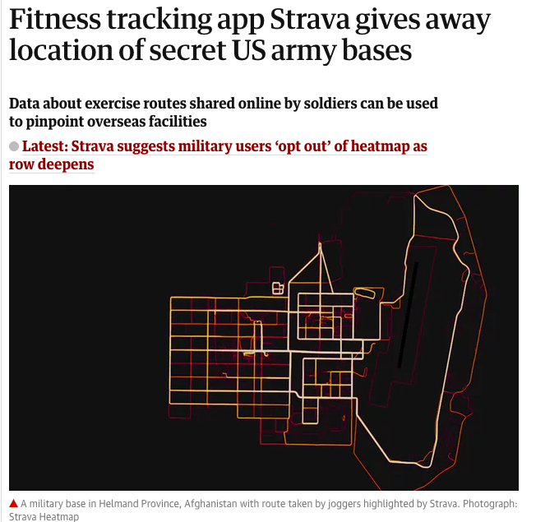

Slide 17
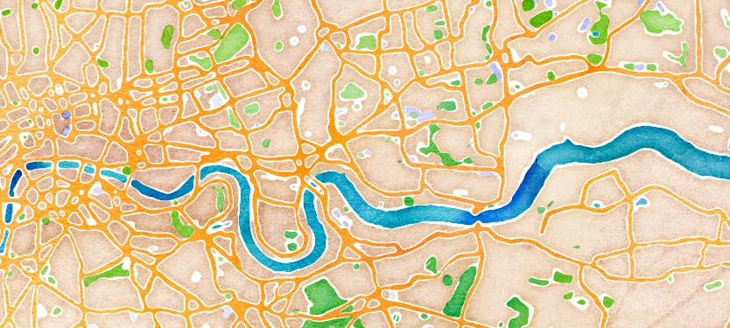

Slide 18
Polygons

Slide 19
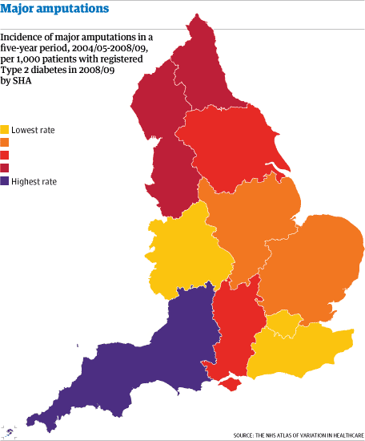

Slide 20
How can you map…
Country | Population (1 June 2016)
China | 1,382,323,332
India | 1,326,801,576
United States | 324,118,787
Indonesia | 260,581,100
Brazil | 209,567,920
Pakistan | 192,826,502
Nigeria | 186,987,563
Bangladesh | 162,910,864

Slide 21
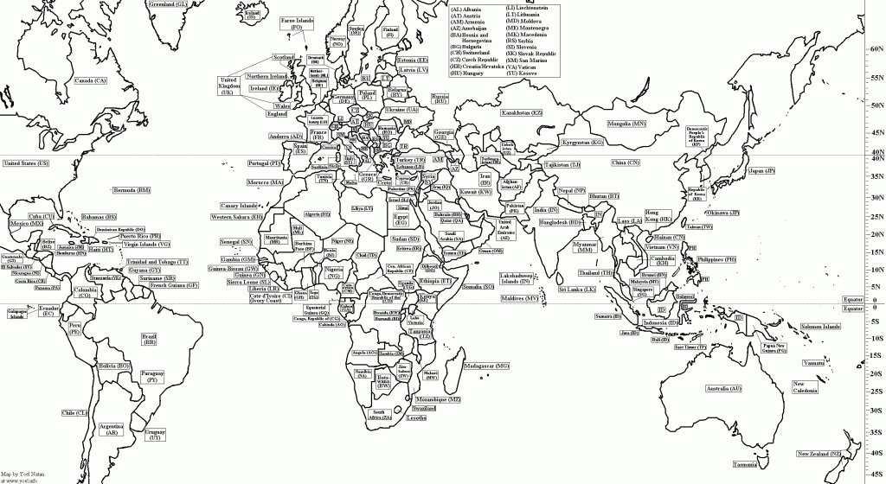
Country | Population (1 June 2016)
China | 1,382,323,332
India | 1,326,801,576
United States | 324,118,787
Indonesia | 260,581,100
Brazil | 209,567,920
Pakistan | 192,826,502
Nigeria | 186,987,563
Bangladesh | 162,910,864

Slide 22
A good map will tell a story and help your analysis

Slide 23
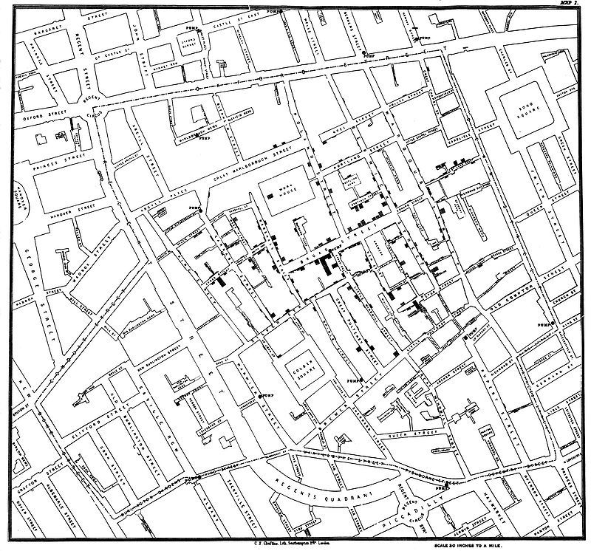

Slide 24
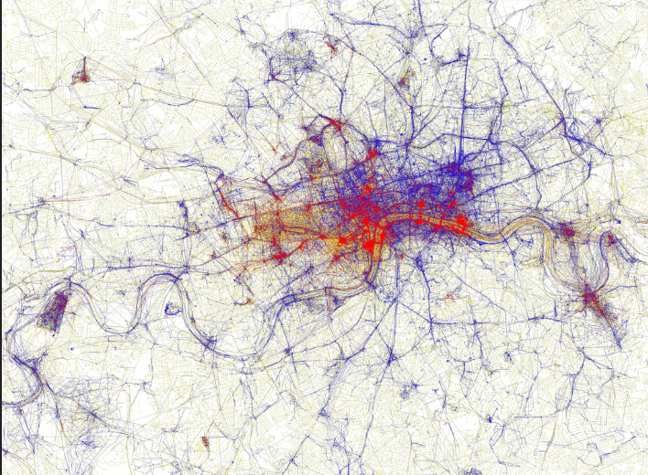
Eric Fischer
https://www.flickr.com/photos/walkingsf/4671589629/in/photostream/

Slide 25
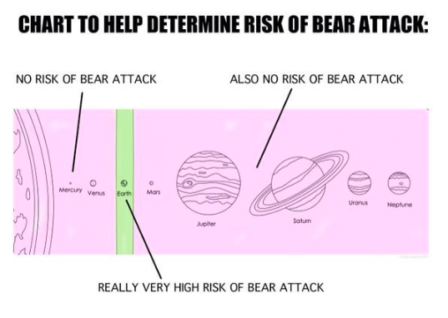

Slide 26
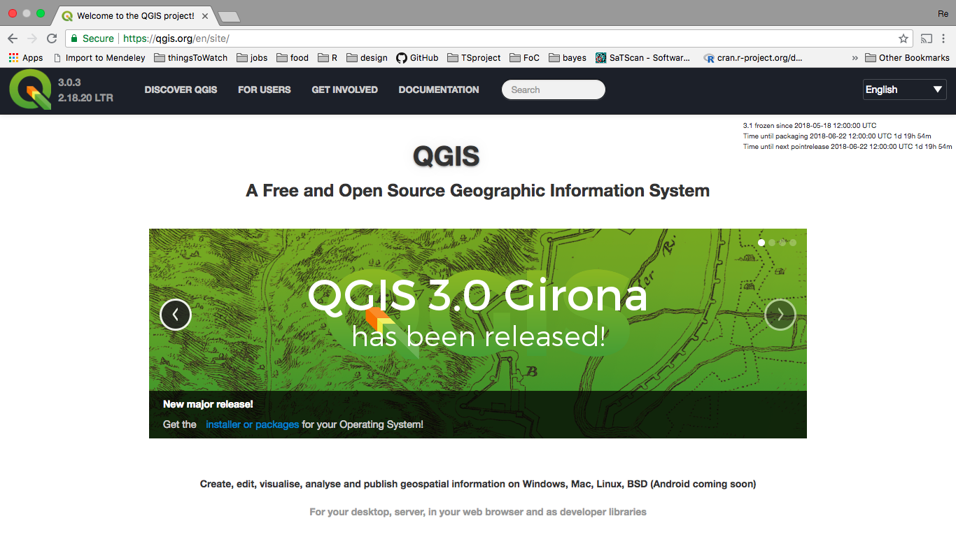
Notes:
http://www.qgis.org/en/site/

Slide 27

Practical lab: making maps in QGIS
goo.gl/RY5BEZ

